Slide 1
Changing Paths: Post Secondary Options/ or Pathways for Students with Disabilities
Ann Palmer, B.A.
abpalmer@nc.rr.com
Baiyina Muhammad, Ph.D.
baiyina.muhammad@gmail.com

Slide 2
Disclaimers
Not too early to be thinking about college as an option for your student; preparation is key
Information today applies to spectrum of learning differences and diagnoses
Our personal experiences, what we’ve learned
Each student is unique, with their own challenges and strengths
What works for one student may not for another
Notes:
Ann

Slide 3
Why We’re Here- Eric

Slide 4
Why We’re Here- Jabreel

Slide 5
K-12 Transition Experience
4 Pivotal Points of transitions
NC-Youth Leadership Forum
Inclusion setting
Transition from middle to HS
Working within and across systems
Challenges
Notes:
The k-12 experience is pretty comprehensive. I will have (4-5) bullet points for this slide.

Slide 6
Is College Possible?
Our students are continuously learning.
College may not seem possible until high school.
Not all students are ready for college immediately after high school.
Academic planning for college starts in middle school, but preparing the student can start much earlier.
Important to think ahead about possibilities and prepare.
Notes:
Baiyina? Sort of an intro to discuss how college is more possible than ever before and how we don’t know when they are young what they will be able to accomplish when older.

Slide 7
Transition Plan under IDEA
First “official” step to planning what comes next
In NC, should be in place by age 14
May be included in annual IEP meeting
Student should attend!
“Movement from school to post-school activities”- post-secondary education, vocational education, supported employment, independent living, and adult services
Notes:
Baiyina?

Slide 8
Preparing for Transition
Envision the future- parent’s vision and student’s vision
Get advice from other parents and professionals
Create practical and useful IEP/ITP goals
Balance focus on academics and functional skills
Notes:
Baiyina

Slide 9
Functional Skills
Independent Living
Will the student be able to live in the community? What level of help might they need?
Personal Hygiene
Can student independently take care of their self- care needs? What skills do they need to work on?
Communication
Can student answer the phone, e-mail, make appointments? Can the student initiate asking for help? Are they able to report information?

Slide 10
Functional Skills
Financial
Can the student use money in a functional way? Can they follow a budget? Who will help?
Transportation
How will the student get around as an adult? Do they know how to access public transportation?
Vocational
What work skills does the student need to do their dream job? How are their interpersonal skills? How much assistance will they need in a job setting?

Slide 11
Differences Between High School and College
High School
Strict mandated class schedule- 30 hrs/wk
Frequent reminders by teachers
Teachers check on understanding
School is required to serve student
College
Student makes own schedule, 15 hrs/wk
Student has to keep track of assignments
Student expected to initiate asking for help
Student must meet academic criteria
Notes:
Ann

Slide 12
How Do We Know if the Student is Ready for College?
Does the student have the academic skills?
Does the student have the organizational
skills needed?
Can the student advocate for themselves?
Can the student be safe on a college campus?
Can the student be independent on a college campus?
Notes:
Ann

Slide 13
Options of Higher Education
Different kinds of schools
Community Colleges and Technical Schools
2-year and 4-year Colleges
Part-time versus full-time
Virtual classes
Commuting or living on campus
Special support programs for students with learning differences
Notes:
Ann

Slide 14
College Support Programs
Programs like College Living Experience (CLE), College Internship Program (CIP)
Intensive support- academic, social, life skills
Programs like Marshall University- West Virginia
Academic, social, independent living supports
http://www.thinkcollege.net
Programs for students with DD/ID
Variety of programs currently in NC
http://www.cidd.unc.edu/psea/
Notes:
Ann- 14 programs located at Community colleges and larger state universities in NC

Slide 15
Admissions Criteria: Beyond Academics at UNC-G
BA/Integrative Community Studies provides support for students with intellectual and/or developmental disabilities at UNC Greensboro. Students must meet the following criteria in order to be considered for possible admission:
Have a documented diagnosis of intellectual disability and/or developmental disability. Refer to the American Association on Intellectual and Developmental Disabilities for the definition of intellectual disability.
Be their own legal guardian
See this Think College brief for more information about decision-making options for young adults with intellectual disabilities
Be at least 18 years old before August 1st of the fall semester for which they are applying
Have concluded secondary education with a diploma, certificate of completion, or equivalent before fall enrollment
Notes:
Baiyina

Slide 16
ICS/BA Admissions Cont.
Must not meet admissions requirements for Undergraduate Admissions
Have basic safety skills in unsupervised settings during non-service hours
Have personal desire and/or support from family to gain necessary skills for self-determination, independent living, and career development
Notes:
Baiyina

Slide 17
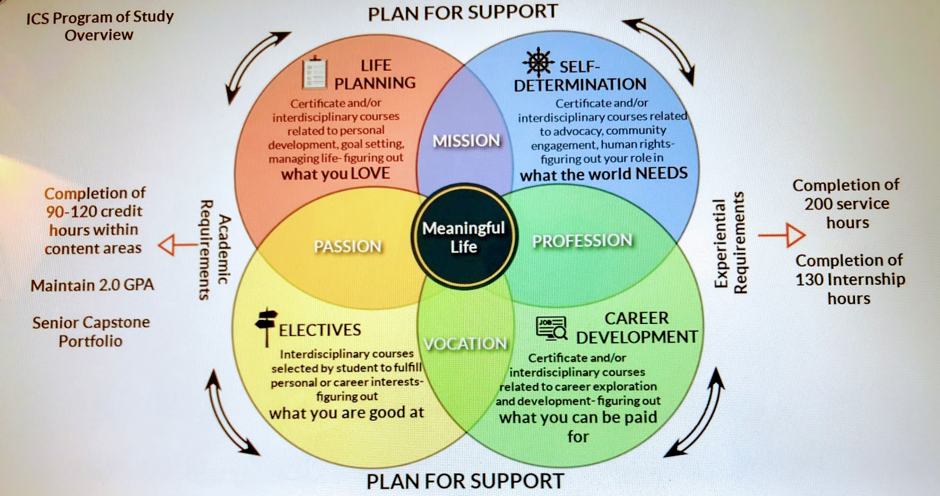
Structure of Certificate Program
Notes:
Baiyina’s discussion about Jay’s experience and talk about Beyond Academics’ support students?
(3) Prong approach for educating and preparing young adults w/intellectual disabilities for an independent life
*Life planning- independent living skills are practiced in real life setting
*Self-determination- like other college peers, ID populations need positive quality of life experiences/education/and advocacy skills to achieve independence
*Voc/Career development – improved employment outcome from college attendance

Slide 18
Full Inclusion College Experience
Student goes through admissions process just like any other student
Student must follow guidelines for all students
Student must disclose if they want accommodations
Parents have limited participation
Student must self-advocate
Notes:
Ann

Slide 19
“Lessons”
Safety - On campus, in dorm room, on the computer
Academic Issues - Study skills, how to know when he needs help and how to get help
Health Issues - How to know if he is sick, who to call, when to go to the doctor
Personal Care - Shaving, showering, laundry
Time Management
Notes:
Ann’s personal story of preparing Eric

Slide 20
Resource Notebook
Information from “lessons”
Contact numbers for family members
Contact info for campus services – RA, computer services, Disability Services, Student Health, etc.
Map of campus and bus routes
Financial, housing, social information
Notes:
Ann’s personal story about strategy for preparing Eric.

Slide 21
Leaving IDEA Behind
No more IEP’s
No more requirements to serve the student
Post-secondary Education Laws
Section 504 of the Rehabilitation Act of 1973
Americans with Disabilities Act of 1990 and ADA Amendments Act of 2008
Notes:
Ann

Slide 22
Implications of 504 and ADA
Those who have qualified for admissions have a right to be in higher education.
Once admitted, students have a right to access all academic and nonacademic programs.
Students have a right to confidentiality of all disability-related information.
Qualified students are eligible to receive REASONABLE accommodations that relate to their disabilities. (level the playing field)
Notes:
Ann

Slide 23
Accommodations
An accommodation is not reasonable if it causes...
a substantial change in an essential element of the curriculum
a substantial change in the manner in which services are provided
an undue financial or administrative burden
Notes:
Ann

Slide 24
Unreasonable Accommodations
Reduced assignments
Exceptions to conduct codes
Personal aides for academics or housing
Retaking of exams
Unlimited extra time on exams
Notes:
Ann

Slide 25
Possible Accommodations
Extended time for testing
Separate setting for testing
Priority seating in classroom
Priority registration
Hard copies of notes
Tape recording lectures
Single dorm room
* Must go through Disabilities Services to access
Notes:
Ann

Slide 26
Disabilities Resource Office
Crucial support for the student fully included
Formal disclosure must happen here to receive services or accommodations
Make connection as early as possible
Regular scheduled appointments if possible
Student needs to develop a comfort level with the office and the staff
Student has to self-advocate!
Notes:
Ann

Slide 27
Learn More About Services Offered
Questions to ask:
What kinds of supports are available for students with learning disabilities?
Does your program have experience serving students with my child’s diagnosis?
What training does your staff receive?
What is a typical case load for a provider in your office?
How often can a student meet with their DS provider?
Does your office provide education for faculty members about working with students with disabilities?
Does your office offer help for the student with self-advocacy skills?
Notes:
Ann (added this)

Slide 28
Self-Advocacy
Student is an adult- has to initiate
Student should understand his/her needs
Student should be able to ask for help and explain why they need help
No information shared with parents unless student requests that in writing
FERPA Waiver- Federal Educational Rights and Privacy Act
Notes:
Ann

Slide 29
Preparing the Student for Self-Advocacy in Adulthood
Involve
Involve the student in school meetings and decisions at whatever level is appropriate
Give
Give student experiences to build communication skills (job on campus, arranging appointments, reporting to teachers, etc.)
Ask
Ask for student’s opinions and feelings (verbal or written)
Make
Always make problem-solving opportunities learning experiences; Allow student to make mistakes
Notes:
Baiyina- Personal Story (Jabreel)

Slide 30
Challenges in College: Jabreel
Organizational problems
Keeping track of courses & assignments
Utilizing systems of support (besides natural support)
Awareness of grades
Building Relationships & Making Connections
Settling disputes with roommate
Finding clubs on campus
Building a rapport with Club members
Learning when to trust and when to be cautious
Notes:
Baiyina’s slide-challenges in College

Slide 31
Support Strategies
Located another support agency besides (Beyond Academic Support through Monarch)
Located a local therapist who has experience working with the population
Provided necessary therapy for J
Frequent reminders
Asking the right questions
Beyond Academics and Monarch Support
Supports from Innovation Waiver (Sandhills/PRC/Voc Rehab/ Therapist/Psychiatrist
Natural Supports (parents/siblings/relatives)
Notes:
Baiyina’s details about strategies for Jabreel

Slide 32
Challenges in College: Eric
Organizational problems
Dealing with changes
Working in groups
Dealing with stress of exams
Communicating with professors
Knowing when he needs help
Prioritizing; understanding what is important
Difficulty with financial and social decisions
Notes:
Ann

Slide 33
Support Strategies
Calendar, lists, schedules
Keeping track of grades, organizers
“Rules” to go by
Frequent reminders
Designating who to go to for help
Regular meetings with professors and DRO
Having a mentor
Relaxation strategies
Asking the right questions
Notes:
Ann

Slide 34
What We’ve Learned
The most difficult parts of college for the student may not be academic related
Start early involving student in advocating
Start early teaching functional skills
Letting go is hard
Parents have to respect the student’s decisions and let them make mistakes
Our children are always learning and they will surprise you
Notes:
Baiyina? (Sure!) Me instead?

Slide 35
Notes:
Ann

Slide 36
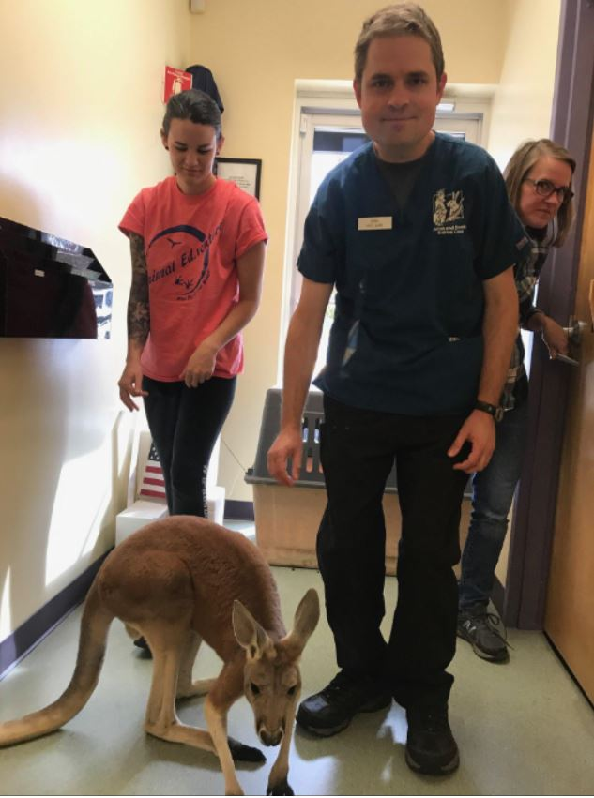
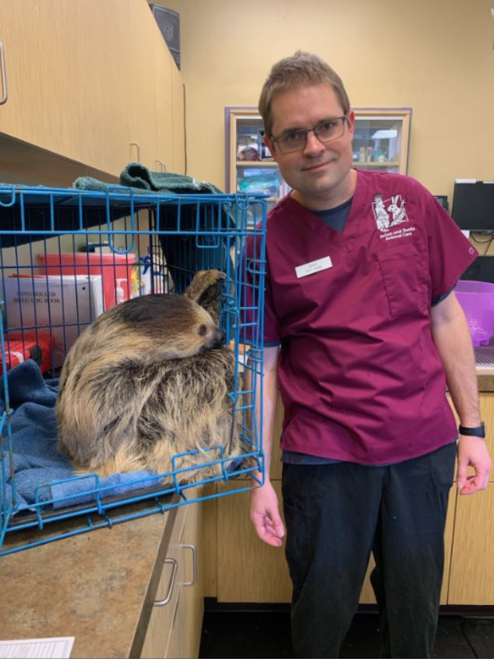
Where is Eric Now?
Notes:
Ann

Slide 37
Notes:
Baiyina

Slide 38
Where is Jabreel Now?
Conference Presenter
Manager of Football Team
Notes:
slide of Jabreel now and Baiyina gives update.

Slide 39
Resources
Autistic Self Advocacy Network (ASAN) https://autisticadvocacy.org/
Benefits of Supporting Individuals with Mild Intellectual Disabilities https://www.ncbi.nlm.nih.gov/pubmed/27461950
College Parenting Central https://www.collegeparentcentral.com/
Dignity of Risk for People with Disabilities https://mydisabilitymatters.com/services/

Slide 40
Resources
National Parent Center on Transition & Employment https://www.pacer.org/transition/learning-center/independent-community-living/self-determination.asp
National Resource Center for Supported Decision Making http://supporteddecisionmaking.org/state-review/north-carolina
Parent Assessments of Self-Determination Importance and Performance for Students with Autism or Intellectual Disability https://pubmed.ncbi.nlm.nih.gov/23301900-parent-assessments-of-self-determination-importance-and-performance-for-students-with-autism-or-intellectual-disability

Slide 41
Resources (Books)
College Success for Students With Learning Disabilities: A Planning and Advocacy Guide for Teens With LD, ADHD, ASD, and More, Simpson and Spencer (2020)
Developing College Skills in Students With Autism and Asperger's Syndrome, Freedman (2010)
Freshman Survival Guide for College Students with Autism Spectrum Disorders: The Stuff Nobody Tells You About!, Moss (2014)
From Disability to Diversity: College Success for Students with Learning Disabilities, ADHD, and Autism Spectrum Disorder, Shea et. al (2019)

Slide 42
Resources (Books) cont.
Navigating College: A Handbook on Self Advocacy Written for Autistic Students from Autistic Adults, ASAN (2013)
The Parent’s Guide to College for Students on the Autism Spectrum, Brown and Wolf et al. (2012)
Preparing for Life; The Complete Handbook of the Transition to Adulthood for Students with Asperger's Syndrome and Autistic Spectrum Disorder, Baker (2006)
Realizing the College Dream with Autism or Asperger Syndrome, Palmer (2006)

